Slide 1


Research Consortium for Crashworthiness in Automated Driving Systems (RCCADS)
Overview: Goals & Structure

Slide 2
Mission
To collaboratively develop a foundation of information that will inform interested parties who seek to develop validation methods for automated driving systems.
The mission is to be accomplished through
pre-competitive research engaging industry, trade associations, NGOs, government, and academia.
RCCADS
Academia
NGOs
Gov’t
Industry

Slide 3
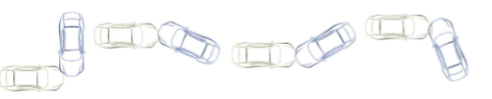
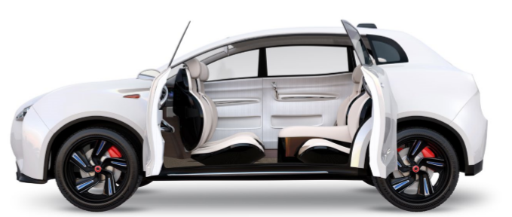
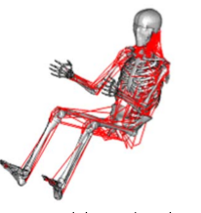
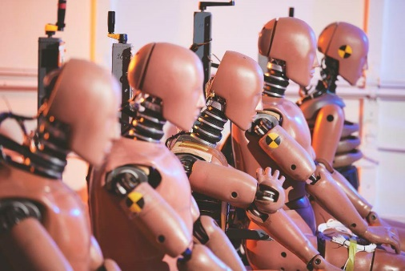
Research Objectives
Projection of future crash modes in which safety validation will be most needed
Create an understanding of non-standard seating and restraints to prioritize test cases for safety validation
Generate biomechanical data that can be used to
  Define injury risk
  Evaluate, update, & develop safety validation tools
Understand what research is underway globally and identify gaps that RCCADS can fill
From Östling et al., 2019
From Automated Driving Systems 2.0: A Vision for Safety
From Östmann et al., 2016

Slide 4
Structure
Consortium Manager (TRC Inc.)
Facilitate consortium operations
Purchasing and project management
Steering Committee
(RCCADS Members)
Contribute funding
Set research agenda and select projects
Review results
Voting and non-voting members
Research and Development Institutions (R&DI) – Universities, R&D Firms, Testing Companies
Bid on, propose, and execute projects
Project Works Groups
Project updates and technical guidance

Slide 5
Annual Timeline
Research Planning (New FY)
Research Planning
Project Award & Kickoff
Project Status Meetings
Project Status Meetings
Deliverable Review
Jun
Jul
Aug
Sep
Oct
Nov
Dec
Jan
Feb
Mar
Apr
May
Jun
Jul
Project Execution

Slide 6
All Membership Levels
  Participation in RCCADS Steering Committee meetings and discussions
  Access to RCCADS deliverables and right to use internally
  Options to nonexclusive, perpetual, nontransferable, royalty-free licenses
Strategic Direction
Introductory
Tool Developer
  No approval required
  Full voting rights:
    Project selection
    Work group selection
    Superseding P&Ps
    Amendments to governance documents
    Introductory member and in-kind contribution approval
    Consortium manager
    Research agenda
    All other decisions
  Approval required
  No voting rights
  Limited to 1 year of membership
  Approval required
  No voting rights
  MOU:
    Willing to provide tools for use in RCCADS projects (good faith effort)
    Pre-competitive collaboration
    No prototype or proprietary tools, unless all members approve
Non-Voting Government
  No approval required
  No voting rights

Slide 7
Becoming an RCCADS R&DI
Notify RCCADS of interest by submitting brief application letter, addressing the following:
  Research organization with structure to accept outside funding for research
  Proven track record for successful research (provide examples of completed research)
  Summarize areas of current or previous research experience that overlap with the goals and scope of RCCADS
  Identify researchers who are qualified to serve as principal investigators (PIs) on RCCADS Projects and provide CV and/or other evidence of relevant experience and qualifications
TRC will review application letter and add organization to qualified R&DI pool
  This process only needs to happen once (not annually)
R&DI will receive RFPs for RCCADS projects in June, with proposals due in July
  Will receive specific RFPs for topics selected by RCCADS members and a general RFP to propose other projects that may be of interest to RCCADS
Projects will selected by RCCADS members and will be awarded in August

Slide 8
Becoming an RCCADS Member
Make a membership commitment (including selection of membership level)
  To participate in the full research planning process, must make a membership commitment by June 1
Select a primary point-of-contact and voting representative
  Multiple representatives from each member are allowed to participate meetings and other activities, but each member is only allowed one vote
Review and sign membership agreement
  All members sign equivalent agreement
Membership fee invoice

Slide 9
Other Ways to Connect with RCCADS
RCCADS public workshops and webinars (hosted at least annually)
Coordinate and collaborate on relevant research projects, for example:
  Partnering on a research project
  Regular research update discussions, to prevent duplicating of efforts
Open to other suggestions (if approved by RCCADS members)

Slide 10
For more details, please contact:
Michelle Fowler, fowlerm@trcpg.com
Ron Burton, burtonr@trcpg.com

Slide 11
Research Consortium for Crashworthiness in Automated Driving Systems (RCCADS)
Overview: Goals & Structure

